Slide 1
UNIT-9 Java Server Faces(JSF)

Slide 2
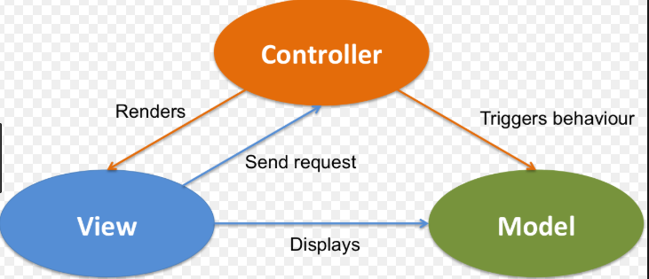
MVC

Slide 3
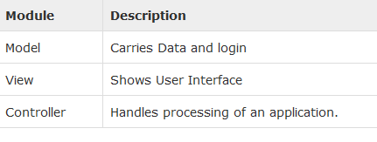

Slide 4
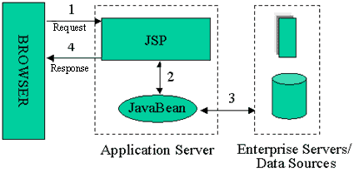
Model 1
Web browser directly accessing Web-tier JSP pages
The JSP pages access Web-tier JavaBeans that represent the application model

Slide 5
What is JavaServer Faces?
JavaServer Faces is:
Web Application Framework
Request-driven MVC
Uses component-based approach
Uses JSP for its display technology, but is not limited to it

Slide 6
JSF versions
Version | Year | J2EE Version
JSF 1.0 | 2004 | J2EE 1.4
JSF 1.2 | 2006 | J2EE5
JSF 2.0 | 2009 | J2EE6
JSF 2.2 | 2013 | J2EE7
JSF 2.3 | EXPECTED IN 2017 | -

Slide 7
Advantages of JSF
Component Based Framework
Implements Facelets Technology
Integration with Expression Language
Support HTML5
Ease and Rapid web Development.
Support Internationalization
Bean Annotations
Default Exception Handling
Templating
Inbuilt AJAX Support
Security

Slide 8
Disadvantages of JSF
This framework is not suitable for high performance applications.
It allows very little control over generated HTML/CSS or JavaScript pages.

Slide 9
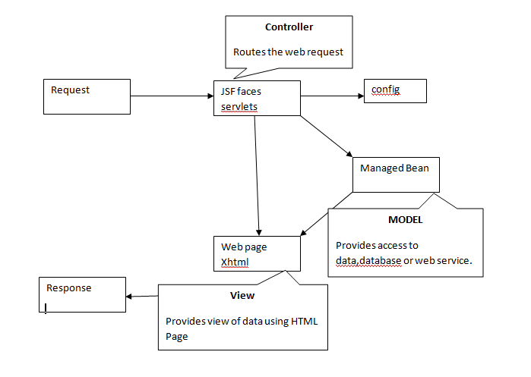
JSF Architecture

Slide 10
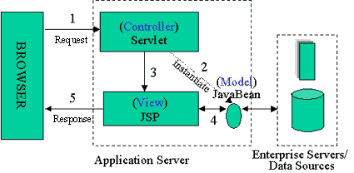
Model 2 (MVC)
Introduces a controller servlet between the browser and the JSP pages or servlet content being delivered
Views do not refer to each other directly

Slide 11
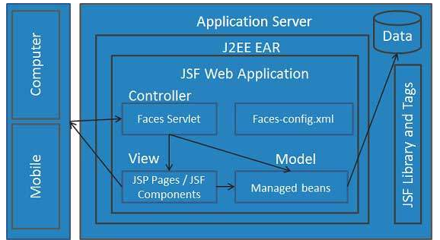

Slide 12
JavaBeans components as models containing application-specific functionality and data
A custom tag library for representing event handlers and validators
A custom tag library for rendering UI components
UI components represented as stateful objects on the server
Server-side helper classes
Validators, event handlers, and navigation handlers
Application configuration resource file for configuring application resources

Slide 13
JSF Request Proccessing Life Cycle
Execute Phase
Restore View Phase
Apply Request Values Phase
Process Validations Phase
Update Model Values Phase
Invoke Application Phase
Render Response Phase
2) Render Phase

Slide 14
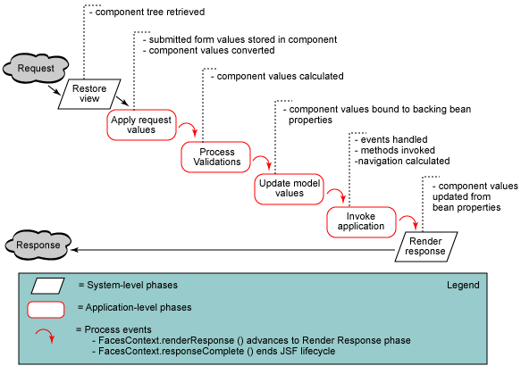
JSF Request Proccessing Life Cycle

Slide 15
JSF application lifecycle consist of six phases which are as follows
1)Restore view phase
2)Apply request values phase; process events
3)Process validations phase; process events
4)Update model values phase; process events
5)Invoke application phase; process events
6)Render response phase

Slide 16
Phase 1: Restore view
JSF begins the restore view phase as soon as a link or a button is clicked and JSF receives a request.
During this phase, the JSF builds the view, wires event handlers and validators to UI components and saves the view in the FacesContext instance. The FacesContext instance will now contains all the information required to process a request.

Slide 17
Phase 2: Apply request values
After the component tree is created/restored, each component in component tree uses decode method to extract its new value from the request parameters. Component stores this value. If the conversion fails, an error message is generated and queued on FacesContext. This message will be displayed during the render response phase, along with any validation errors.
If any decode methods / event listeners called renderResponse on the current FacesContext instance, the JSF moves to the render response phase.

Slide 18
Phase 3: Process validation
During this phase, the JSF processes all validators registered on component tree. It examines the component attribute rules for the validation and compares these rules to the local value stored for the component.
If the local value is invalid, the JSF adds an error message to the FacesContext instance, and the life cycle advances to the render response phase and display the same page again with the error message.

Slide 19
Phase 4: Update model values
After the JSF checks that the data is valid, it walks over the component tree and set the corresponding server-side object properties to the components' local values. The JSF will update the bean properties corresponding to input component's value attribute.
If any updateModels methods called renderResponse on the current FacesContext instance, the JSF moves to the render response phase.

Slide 20
Phase 5: Invoke application
During this phase, the JSF handles any application-level events, such as submitting a form / linking to another page.

Slide 21
Phase 6: Render response
During this phase, the JSF asks container/application server to render the page if the application is using JSP pages. For initial request, the components represented on the page will be added to the component tree as the JSP container executes the page. If this is not an initial request, the component tree is already built so components need not to be added again. In either case, the components will render themselves as the JSP container/Application server traverses the tags in the page.
After the content of the view is rendered, the response state is saved so that subsequent requests can access it and it is available to the restore view phase.

Slide 22
2) Render
Application is compiled, when a client makes an initial request for the index.xhtml web page.
Application executes after compilation and a new component tree is constructed for the application and placed in a FacesContext.
The component tree is populated with the component and the managed bean property associated with it, represented by the EL expression.
Based on the component tree. A new view is built.
The view is rendered to the requesting client as a response.
The component tree is destroyed automatically.
On subsequent requests, the component tree is rebuilt, and the saved state is applied.

Slide 23
JSF Managed Bean
Validating a component's data
Handling an event fired by a component
Performing processing to determine the next page to which the application must navigate

Slide 24
1.Create managed Bean
public class User {
private String name;
public String getName() {
return name;
}
public void setName(String name) {
this.name = name;
}
}

Slide 25
2.Configure Managed Bean
By configuring into XML file.
By using annotations.

Slide 26
Configuring Managed Bean into XML file(faces-config.xml)
<managed-bean>
<managed-bean-name>user</managed-bean-name>
<managed-bean-class>User</managed-bean-class>
<managed-bean-scope>session</managed-bean-scope>
</managed-bean>

Slide 27
Configuring Managed Bean using Annotations
import javax.faces.bean.ManagedBean;
import javax.faces.bean.RequestScoped;
@ManagedBean // Using ManagedBean annotation
@RequestScoped // Using Scope annotation
public class User {
private String name;
public String getName() {
return name;
}
public void setName(String name) {
this.name = name;
}
}

Slide 28
Scope
Application (@ApplicationScoped): Application scope persists across all users? interactions with a web application.
Session (@SessionScoped): Session scope persists across multiple HTTP requests in a web application.
View (@ViewScoped): View scope persists during a user?s interaction with a single page (view) of a web application.
Request (@RequestScoped): Request scope persists during a single HTTP request in a web application.
None (@NoneScoped): Indicates a scope is not defined for the application.
Custom (@CustomScoped): A user-defined, nonstandard scope. Its value must be configured as a java.util.Map. Custom scopes are used infrequently.

Slide 29
2.create JSF page & Use managed Bean to retreive data

Slide 30
JSF Page Structure
<?xml version='1.0' encoding='UTF-8' ?>
<!DOCTYPE html PUBLIC "-//W3C//DTD XHTML 1.0 Transitional//EN" "http://www.w3.org/TR/xhtml1/DTD/xhtml1-transitional.dtd">
<html xmlns="http://www.w3.org/1999/xhtml"
xmlns:h="http://xmlns.jcp.org/jsf/html"
xmlns:c="http://java.sun.com/jsf/core"
xmlns:ui="http://java.sun.com/jsf/facelets">
<h:head>
<title>Facelet Title</title>
</h:head>
<h:body>
Hello this is my first JSF program
<h:form>
</h:form>
</h:body>
</html>

Slide 31
JSF Commonly Used Tags
Notes:
*
(c) 2007 National Academy for Software Development - http://academy.devbg.org. All rights reserved. Unauthorized copying or re-distribution is strictly prohibited.*
31##

Slide 32
JSF Namespaces
JSF Component | Tag Used | JSF Namespace
Core Component | f | http://xmlns.jcp.org/jsf/core
HTML components | h | http://xmlns.jcp.org/jsf/html
Facelets components | ui | http://xmlns.jcp.org/jsf/facelets
Composite components | cc | http://xmlns.jcp.org/jsf/composite

Slide 33
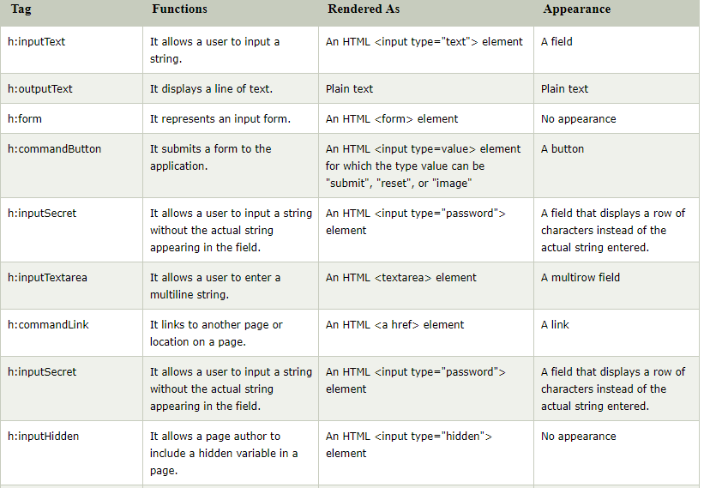
JavaServer Faces HTML tag library

Slide 34
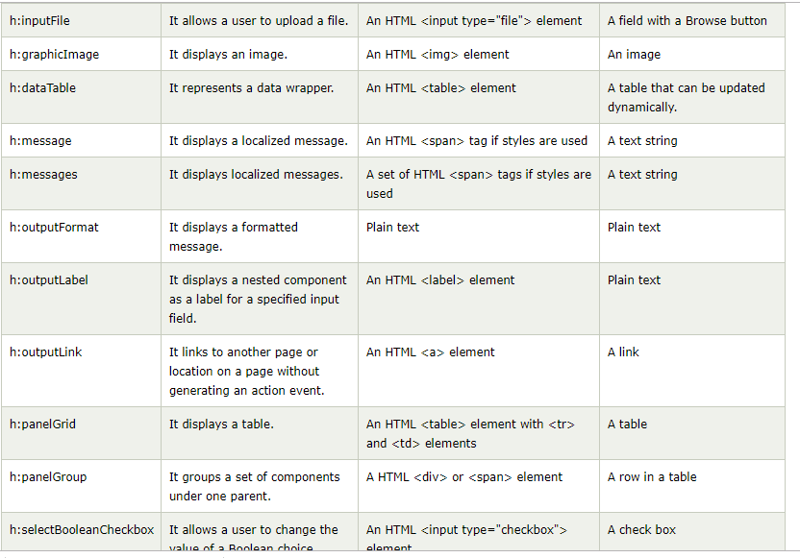

Slide 35
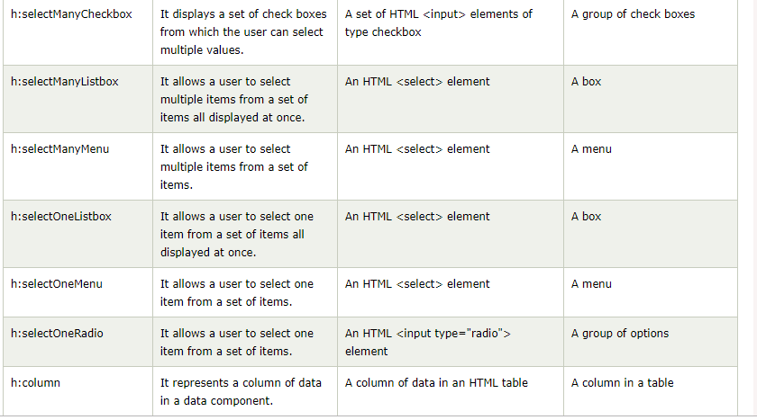

Slide 36
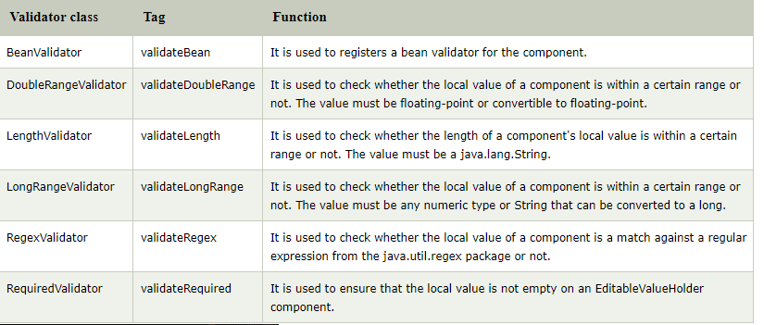
JSF Validation

Slide 37
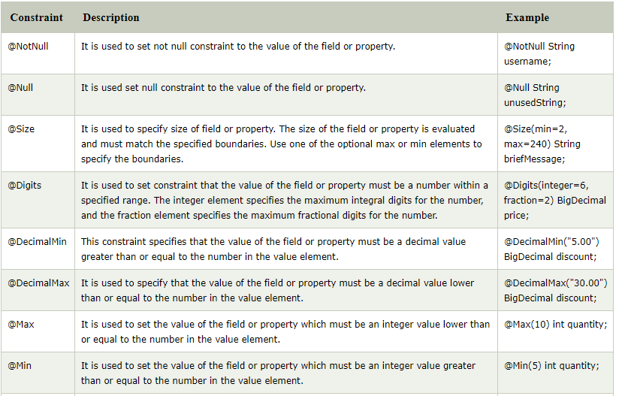
<f:validateBean>
Built-In Bean Validation Constraints

Slide 38
import javax.faces.bean.ManagedBean;
import javax.faces.bean.RequestScoped;
import javax.validation.constraints.NotNull;
@ManagedBean
@RequestScoped
public class User{
@NotNull(message = "Name can't be null")
String name;
public String getName() {
return name;
}
public void setName(String name) {
this.name = name;
}
}

Slide 39
<h:form id="form">
<h:outputLabel for="username">User Name</h:outputLabel>
<h:inputText id="name-id" value="#{user.name}">
<f:validateBean/>
</h:inputText><br/>
<h:commandButton value="OK" action="response.xhtml"></h:commandButton>
</h:form>

Slide 40
<f:validateDoubleRange>
<h:outputLabel for="amount">Enter Amount </h:outputLabel>
<h:inputText id="name-id" value="#{user.amount}" validatorMessage="Please enter amount between 1000.50 and 5000.99">
<f:validateDoubleRange minimum="1000.50" maximum="5000.99"/>
</h:inputText><br/><br/>
<h:commandButton value="Submit" action="response.xhtml"></h:commandButton>
</h:form>

Slide 41
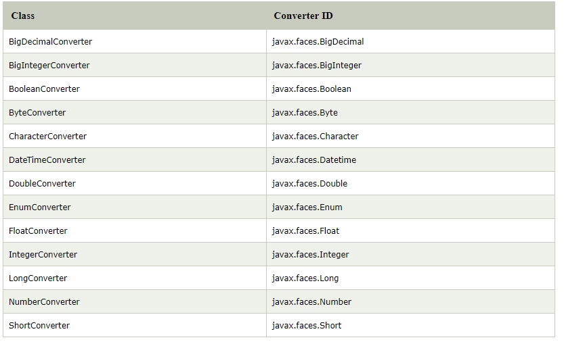
JSF Converters

Slide 42
JSF NumberConverter Example: 1.Create managed bean
import javax.faces.bean.ManagedBean;
import javax.faces.bean.RequestScoped;
@ManagedBean
@RequestScoped
public class User {
String name;
int shirtPrice;
public String getName() {
return name;
}
public void setName(String name) {
this.name = name;
}
public int getShirtCost() {
return shirtPrice;
}
public void setShirtCost(int shirtPrice) {
this.shirtPrice = shirtPrice;
}
}

Slide 43
JSF NumberConverter Example: 2.create JSF & use Managed bean
<h:form>
<h:outputLabel for="username">User Name</h:outputLabel>
<h:inputText id="user-id" value="#{user.name}"/><br/>
<h:outputLabel for="shirtPrice">Shirt Price</h:outputLabel>
<h:inputText id="shirtPrice-id" value="#{user.shirtCost}" autocomplete="off">
<f:convertNumber currencySymbol="$" type="currency"/>
</h:inputText>
<br/>
<h:commandButton action="response.xhtml" value="Submit"/>
</h:form>

Slide 44
JSF Referencing Managed Bean Method
Action:It is used to refer a managed bean method that performs navigation processing for the component and returns a logical outcome String.

Slide 45
Referring Bean Method
import javax.faces.bean.ManagedBean;
import javax.faces.bean.RequestScoped;
@ManagedBean
@RequestScoped
public class User {
String name;
String mobile;
public String getName() {
return name;
}
public void setName(String name) {
this.name = name;
}
public String getMobile() {
return mobile;
}
public void setMobile(String mobile) {
this.mobile = mobile;
}
// It is used to perform navigation process
public String submit(){
return "response.xhtml";
}
}

Slide 46
P1.xhtml
<h:form>
<h:outputLabel for="User name">User Name</h:outputLabel>
<h:inputText id="name-id" value="#{user.name}"/><br/>
<h:outputLabel for="mobile">Enter Mobile</h:outputLabel>
<h:inputText id="mobile-id" value="#{user.mobile}"/><br/>
<h:commandButton action="#{user.submit()}" value="submit"></h:commandButton>
</h:form>

Slide 47
P1.xhtml
<h:body>
<h1>
Hello #{user.name}
</h1>
<h:outputLabel value="Your Mobile is: #{user.mobile}"/>
</h:body>

Slide 48
Facelets JSF Tags
The web application provides various web pages.each web page has some standard layout and style to display the contents.
Typical layout of a page is as follows
Header
Content
Footer

Slide 49
Facelets JSF Tags
JSF provides special tags to create common layout for a web application called facelets tags. These tags gives flexibility to manage common parts of a multiple pages at one place.
For these tags you need to use the following namespaces of URI in html node.
<html xmlns="http://www.w3.org/1999/xhtml" xmlns:ui="http://java.sun.com/jsf/facelets" >

Slide 50
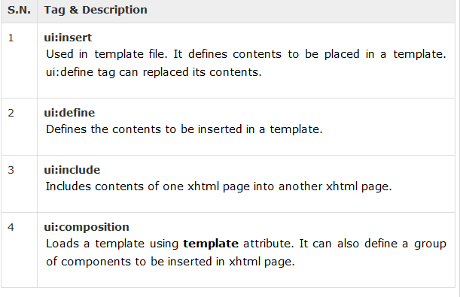

Slide 51
<div id="top">
<ui:insert name="top">Top</ui:insert>
</div>
<div>
<div id="left">
<ui:insert name="left">Left</ui:insert>
</div>
<div id="content" class="left_content">
<ui:insert name="content">Content</ui:insert>
</div>
</div>
<div id="bottom">
<ui:insert name="bottom">Bottom</ui:insert>
</div>

Slide 52
<ui:composition template="./template.xhtml">
<ui:define name="header">
<h:graphicImage value="/resources/images/header.png"/>
</ui:define>
<ui:define name="index">
<h:graphicImage value="/resources/images/index.png"/>
</ui:define>
<ui:define name="content">
<h:graphicImage value="/resources/images/content.png"/>
</ui:define>
<ui:define name="footer">
<h:graphicImage value="/resources/images/footer.png"/>
</ui:define>
</ui:composition>

